Slide 1
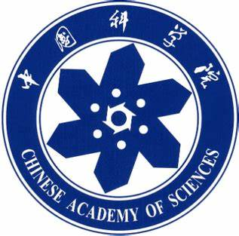
Chongqing University of Technology
ATAI
Advanced Technique of Artificial Intelligence
Chongqing University of Technology
Representation Learning with Hypergraphs
Jaehyeong Jo1, Jinheon Baek1, Seul Lee1,
Dongki Kim1, Minki Kang1, Sung Ju Hwang1;2
KAIST1, AITRICS2, South Korea
harryjo97@kaist.ac.kr, jinheon.baek@kaist.ac.kr,
ellenlee7890@gmail.com, cleverki@kaist.ac.kr,
zzxc1133@kaist.ac.kr, sjhwang82@kaist.ac.kr
Code : https://github.com/harryjo97/EHGNN
NIPS_2021
Reported by Xinsheng Wang

Slide 2
Chongqing University of Technology
ATAI
Advanced Technique of Artificial Intelligence
Chongqing University of Technology
1.Introduction
2.Method
3.Experiments

Slide 3
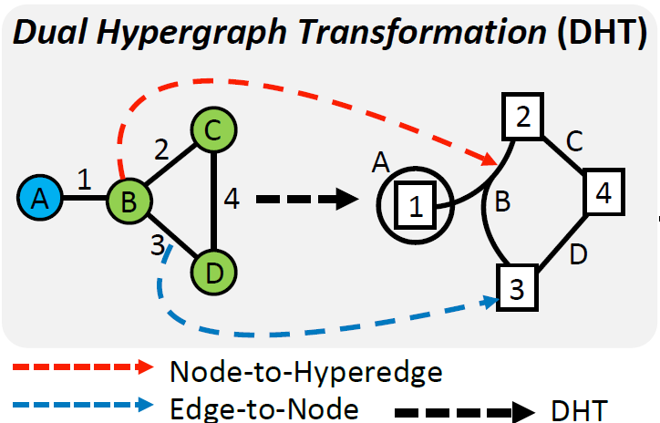
Introduction
Notes:
之前有关图的工作都是用邻居结点增强自身的表示，很少用到边的表示。本文提出一种超图结构。

Slide 4
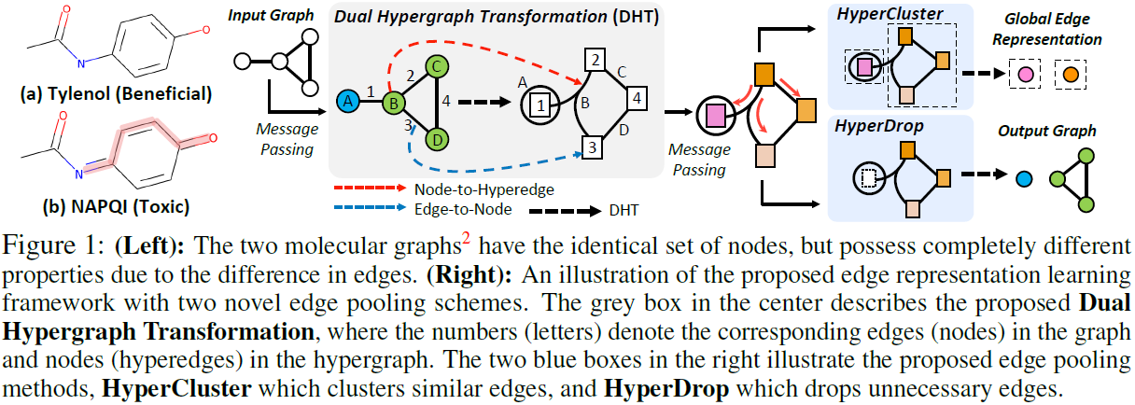
Method

Slide 5
Method
Edge representation learning with dual hypergraph transformation

Slide 6
Method
Graph-level edge representation learning with edge pooling
HyperCluster
Notes:
这里是一个变换维度的操作，将结点或者边数量进行一个降维，即合并某些相似的结点或边(这里是通过线性变换实现的)。

Slide 7
Method
Graph-level edge representation learning with edge pooling
HyperDrop
Notes:
代码中用tanh算的score；
代码中g_pool是将三个表示拼接起来进行分类；
hyperDrop主要是挑选出重要的结点特征和重要的边特征；

Slide 8
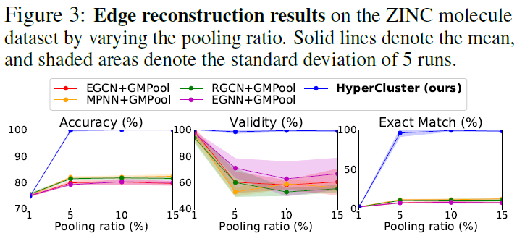
Experiments
Notes:
在边重构任务上的效果

Slide 9
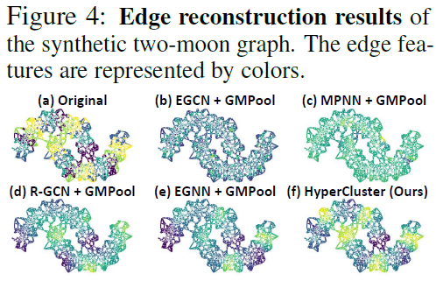
Experiments

Slide 10
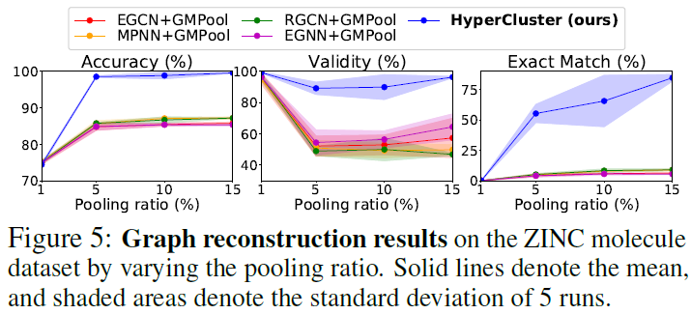
Experiments

Slide 11
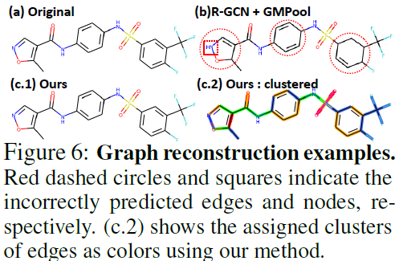
Experiments

Slide 12
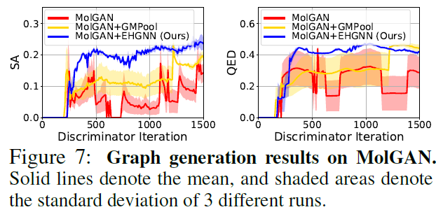
Experiments

Slide 13
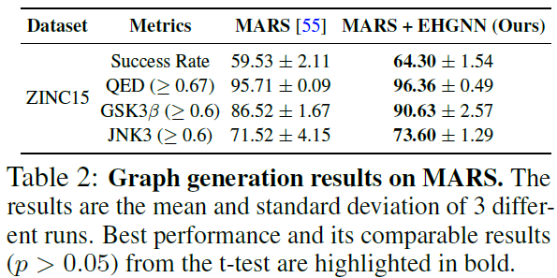
Experiments

Slide 14
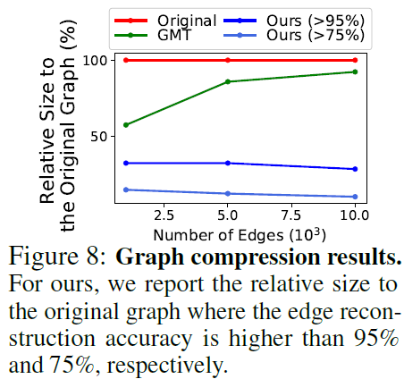
Experiments

Slide 15
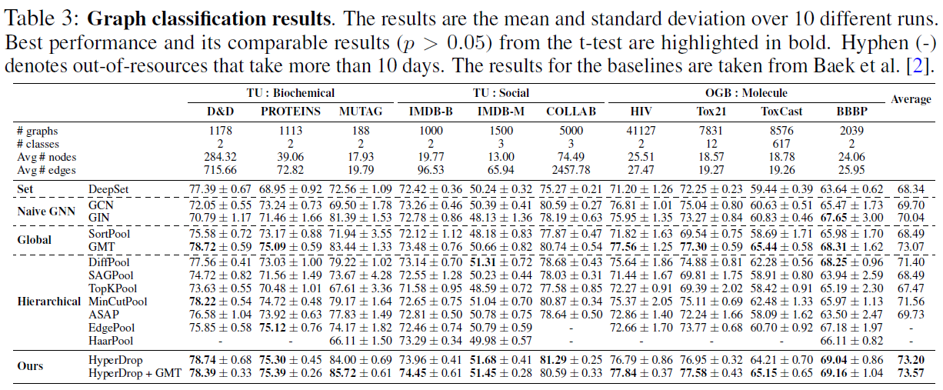
Experiments
Notes:
加了插件GMT有的数据集的效果还比不上只有GMT的

Slide 16
Experiments

Slide 17
Thank you!

